Slide 1

Oromia Seed Enterprise
Presented by Eliyas Siyoum
Supervisor: Mr.Tefera

Slide 2
Background
Background:
a company with a big main office and 6 smaller offices in different locations. The main office has three buildings, all within a kilometer from each other. Each building has 10 floors, and each floor has 60 people working there. To make things easier, each floor is divided into 3 smaller groups of people.
The company wants to make their main office a super-secure place where they store all their important data (like a data center). They also want to make sure that all their offices, both the main one and the branch ones, are protected and can share information safely.

Slide 3
Statement of the Problem:
This company needs to design a network that connects all their offices, is secure, and can handle all the data traffic from so many people. They need to figure out how to:
Connect the three buildings in the main office:
They need a fast and reliable way to share data between these buildings.
Connect the main office to the branch offices:
They need a way to securely connect all their offices and share data between them.
Protect the data:
They need to make sure that their data is safe from hackers and other threats.
Manage the network:
They need a way to easily manage and control the network, especially with so many users and devices.

Slide 4
Objective of the project
General Objective
Transform the head office into a secure and efficient data center, capable of centralizing data, distributing network security, and facilitating evidence sharing across the organization, including its six branches.
Specific objectives
Centralize Data Storage:
Consolidate all critical data from the head office's three buildings and six branches into a central data center within the head office.
Distribute Network Security:
Implement a layered security approach across the entire network, including the head office buildings and branches.

Slide 5
Objective continues..
Design and deploy a secure network infrastructure that effectively isolates "workgroup links" (VLANs or other logical groupings) for enhanced security.
Facilitate Evidence Sharing:
Implement tools and procedures for collecting, analyzing, and sharing evidence of security incidents.
Addressing and Secure "Workgroup Links": Implement security measures for each "workgroup link" to isolate traffic and control access within specific groups by using vlans

Slide 6
Scope
1. Network Infrastructure:
Head Office:
Upgrade and secure the network infrastructure within the three head office buildings, including:
Configuring VLANs to isolate traffic and enhance security.
Branches
Upgrade and secure the network infrastructure at each of the six branches

Slide 7
Network requirement analysis
Hardware requirement
Network Devices:
Server
in this project I used one server
Distribution Switches:
distribution switches to connect the access layer to the core
3nmultilayer for the head office and 1 per each branches
Access Switches:
30 access switches (10 per building) for head office to provide connectivity to end-users and wireless access points and 2 access switches per branches with one multilayer switches.
Internet Router: 4 routers.
Cables :Serial DCE cables,Straight through cable ,Fiber optic cabling for the core and distribution layer links

Slide 8
Network requirement analysis
End devices
PC
printer
Core Switches
high-performance core switches to provide the backbone connectivity and redundancy
We use also power and cooling tools

Slide 9
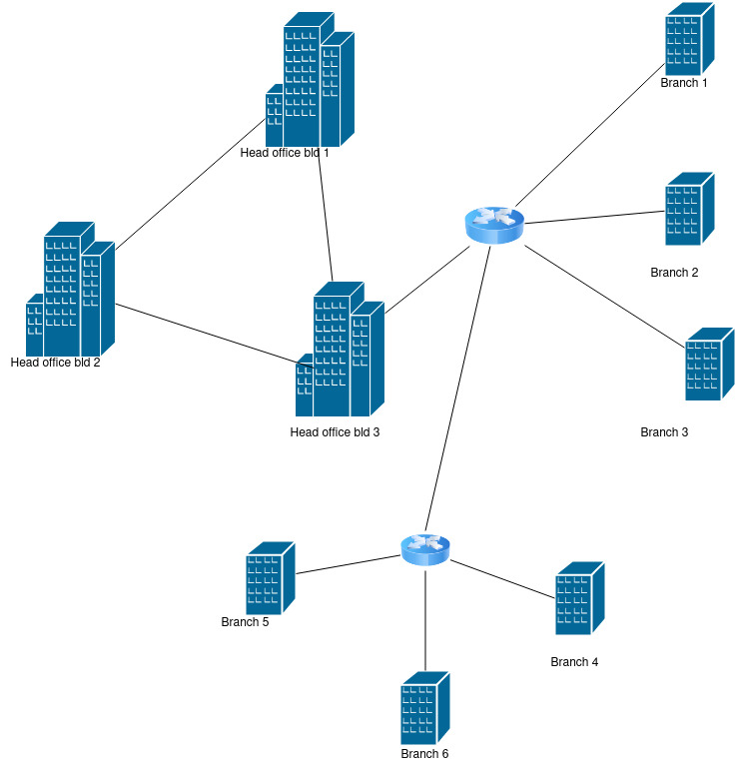
Topology design

Slide 10
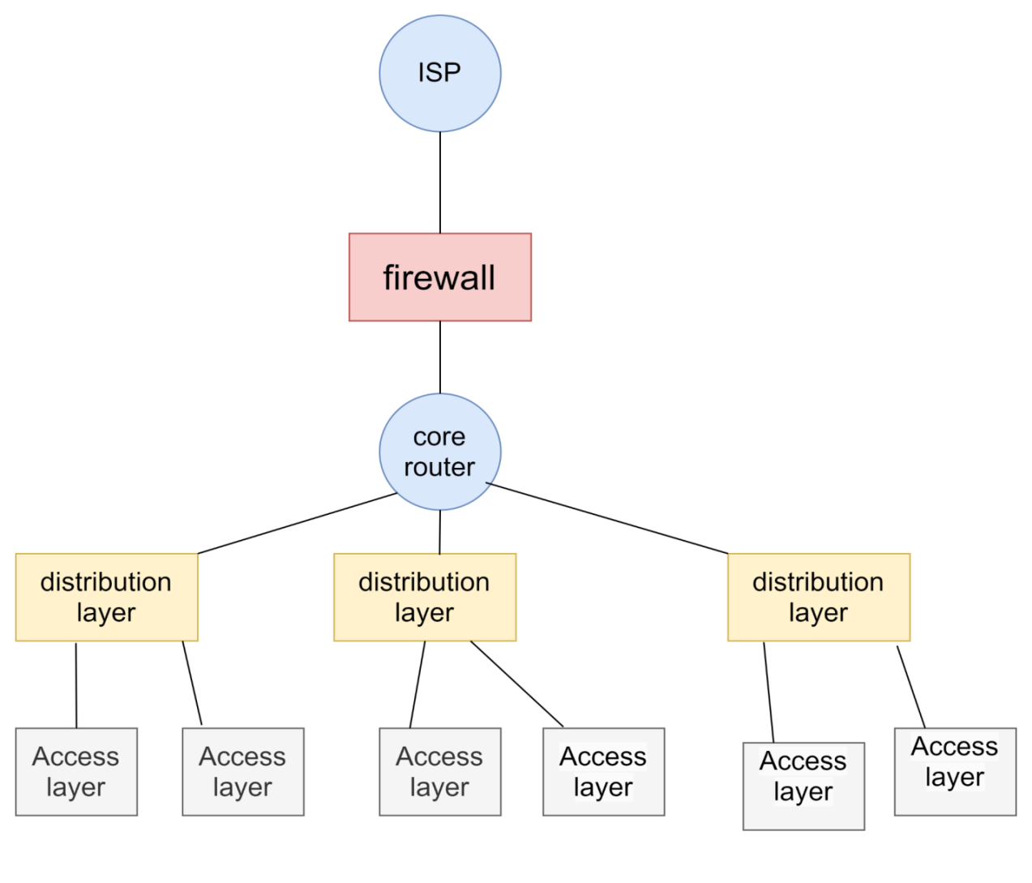
Network topology design

Slide 11
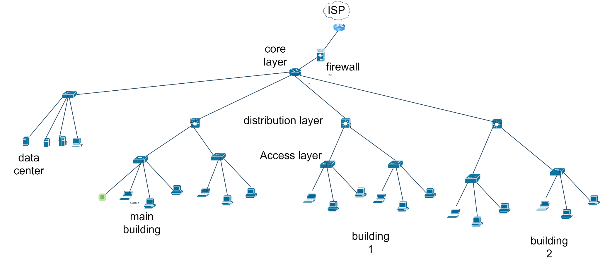
Network topology design…

Slide 12
IP network design guidelines
DHCP
Use DHCP to assign addresses to individual PCs
Use static addressing only for network equipment, printers, and servers DHCP
Dynamic Host Configuration Protocol
Used to assign IP address and provide basic IP configuration to a host.
Simplifies your life greatly
– Faster
– Fewer mistakes
– Easier renumbering
In order to centralize your DHCP service, you need a DHCP relay on each subnet
– Most routers provide this feature
you grow, add another server and run as a failover pair

Slide 13
IP network design guidelines
DNS
DNS reliability is essential to your network
– No DNS == No services
Separate duties – Authoritative and recursive on different machines
IP Address Class: Use a Class C IP address block.
Class C addresses have the network prefix 192.168.0.0/24 to 192.168.255.255/24.
This provides a total of 256 IP addresses, with 254 usable addresses (excluding the network and broadcast addresses).

Slide 14
Subnetting
Subnetting:
is the process of dividing a larger network into smaller, more manageable sub-networks, or subnets. It involves taking a single IP address and splitting it into multiple, smaller IP addresses that can be used to create separate networks.
We know that there are a total 32 bits in IP address /24 means that 24 bits are parts of the network portion and the remaining 32-24 = 8 bits are the parts of the host portion

Slide 15
Sample configuration command
on multi layer switch
to trunk the mode
switchport trunk encapsulation dot1q
switchport mode trunk
on each access layer switch switch
int range fa0/1-24
switchport mode access
switchport access vlan number
exit
do wr
on multilayer switch
Switch(config)#int fa0/4
Switch(config-if)#switchport mode access
Switch(config-if)#switchport access vlan 130

Slide 16
Sample configuration command
To create subclass from class we use the following command
Router>enable
Router#config t
Router(config)#int gig0/0.10
Router(config-subif)#encapsulation dot1q 10
Router(config-subif)#ip add 192.168.1.1 255.255.255.0
Router(config-subif)#ex

Slide 17
DHCP configuration
dhcp ip giving
on router
Router(config)#service dhcp
Router(config)#ip dhcp pool B4office1-pool
Router(dhcp-config)#network 192.168.37.0 255.255.255.0
Router(dhcp-config)#default-router 192.168.37.1
Router(dhcp-config)#dns-server 192.168.37.1
Router(dhcp-config)#ex

Slide 18
Conclusion
At the end the project worked almost meet what required to be.
Server gave the ip address for each pc using dhcp.
Head office and branches can communicate within themselves and to one another.

Slide 19
Reference
Reference
Network Infrastructure Design – Planning a Campus Network (networkencyclopedia.com)
Computer Network Tutorial - GeeksforGeeks
Campus Network Design Guideline - Cisco Community

Slide 20

Last page

